Slide 1

Input Output Streams

Slide 2

Stream
Stream is an Object used to transfer the data from input unit to memory, memory to output unit.
InputStream
  Used to read the data from any input resource
OutputStream
  Used to write the data on to the output resource.

Slide 3
IN PUT
RESOURCE
R
A
M
OUTPUT
RESOURCE
INPUT STREAM
OUTPUT STREAM
Example:
Key Board
File
Object
Example:
Console
File
Object

Slide 4
Types of Stream in JAVA
Byte Based Stream
  InputStream
  OutputStream
  Preferred for binary files / raw data like images / graphs
Character Based Stream
    Reader
    Writer
    Preferred for char[Unicode] text files : 16 bits
IOIOIOIOIOIOIOIOIOIOI
ABCDEFGHIJKLMNOP

Slide 5
Types of Stream in JAVA
HIGH LEVEL STREAMS Primitive Type +Object Types
BufferedInputStream
BufferedOutputStream
DataInputStream
DataOutputStream
LOW LEVEL STREAMS : Raw data
System.in
FileInputStream
FileOutputStream
System.out
RESOURCES
Key Board
File
Console

Slide 6
Object
InputStream
OutputStream
FileInputStream
FileOuputStream
PrintStream
FilterInputStream
FilterOutputStream
BufferedInputStream
DataInputStream
DataOutputStream
BuffredOutputStream

Slide 7
Basic Input/Output Streams
Reading from Keyboard (Input)
  int n=System.in.read() // one byte
  System.in.read(byte[])// no of bytes
  System.in.read(byte[], int, int)//read no of bytes starting from specified position upto specified length
Sending to Console (Output)
System.out.println(“String”+variables)System.out.print(“String”+variables)

Slide 8
File Input Streams
FileInputStream fis =
new FileInputStream(“FileName”); new FileInputStream(File f);
methods:
int n = fis.read();
int n = fis.read(byte[]);
int n = fis.read(byte[], int, int);

Slide 9
File Output Streams
FileOutputStream fos =
new FileOutputStream(“FileName”);
new FileOutputStream(File f);
new FileOutputStream(“FileName”, boolean);
methods:
fos.write(int n);

Slide 10
OBJECT
READER
WRITER
BufferedReader
InputStreamReader
BufferedWriter
OutputStreamWriter
FileReader
FileWriter

Slide 11
Reader
BufferedReader br=new BufferedReader( new InputStreamReader(System.in));
BufferedReader br=new BufferedReader( new FileReader(“FileName”));
Methods:
    int n=br.read()
    int n=br.read(char[ ], int , int )
    String s=br.readLine();

Slide 12
Writer
BufferedWriter bw = new BufferedWriter( new OutputStreamWriter(System.out));
BufferedWriter bw = new BufferedWriter( new FileWriter(“FileName”));
Methods:
    bw.write(int);
    bw.write(char[], int, int);
    bw.write(String s);

Slide 13
File
File is an Object which is an abstract representation of file and directory pathnames.
This class presents system-independent view of hierarchical pathnames.
File has two components:
  Directory pathname
  File / SubDirectory name.

Slide 14
File
File f = new File(String pathname)
File f = new File(String dir, String filename)
File f = new File(File parent, String filename)

Slide 15
Methods of File Object
String[] fn = f.list();
boolean b = f.exists();
boolean b = f.isFile();
boolean b = f.isDirectory();
boolean b = f.canWrite();
boolean b = f.canRead();
String path = f.getPath();
long l = f.lenth();
long t = f.lastModified(); etc…..

Slide 16
RandomAccessFile
It is not an input or output stream. It is an object which directly allows random reading or writing the data into the file.
Modes of Accessing the file:
“r” -- Read Mode , “rw”– Read & Write Mode
RandomAccessFile raf = new RandomAccessFile(String name, String mode)
RandomAccessFile raf = new RandomAccessFile(File name, String mode)

Slide 17
Methods of RandomAccessFile
int n = raf.read();
All methods of DataInputStream
raf.write(int n);
All the methods of DataOutputStream
long l = raf.length();
long p = raf.getFilePointer;
f.seek(long p);

Slide 18
FilenameFilter
It is an interface used to filter the filenames.
Process of filtering is done by abstract method of accept(File dir, String filename) which returns boolean value.
list() method of File and Dialog object will depend on accept() method to list out file names of the specified directory.
Filtering completely depends on how accept() method is overridden.

Slide 19
FilenameFilter
import java.io.*;
class NewFilter implements FilenameFilter
{ String ext;
NewFilter(String ext)
{ this.ext=ext;
}
  public boolean accept(File f, String fn)
  { return s.endsWith(ext);
  }
  }

Slide 20
FilenameFilter
  class Demo
  {
  public static void main(String[] v)
  {
  NewFilter nf=new NewFilter(“.java”);
  File f=new File(“c:\chakri”);
  String[ ] fns=f.list(nf);
  }
  }

Slide 21
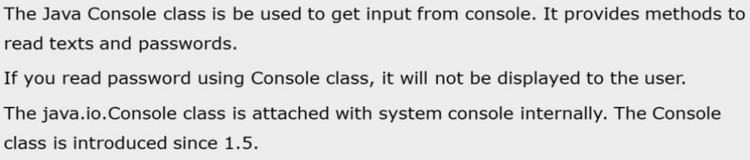
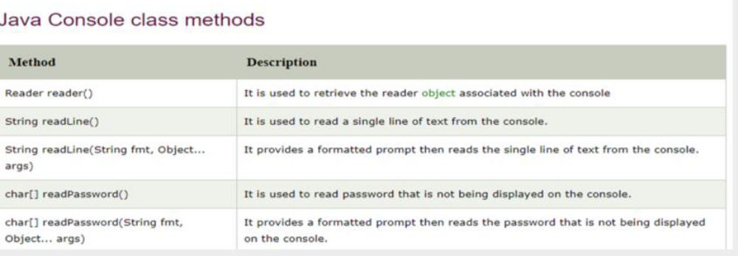
Console Class

Slide 22
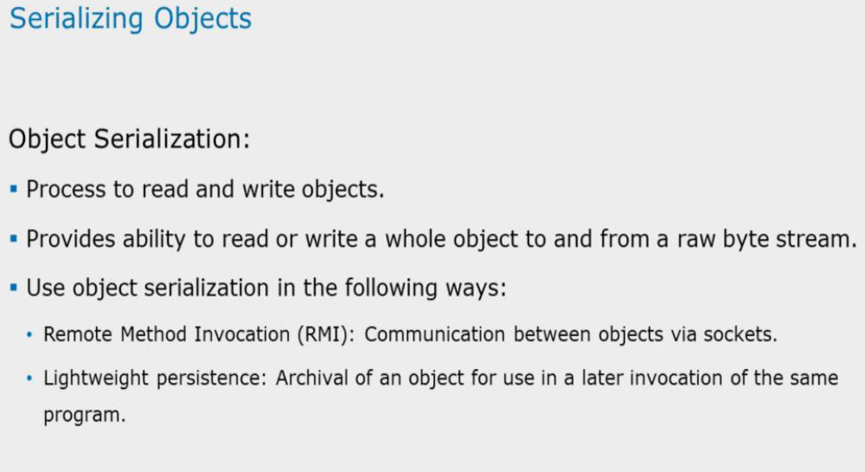
Serializing

Slide 23
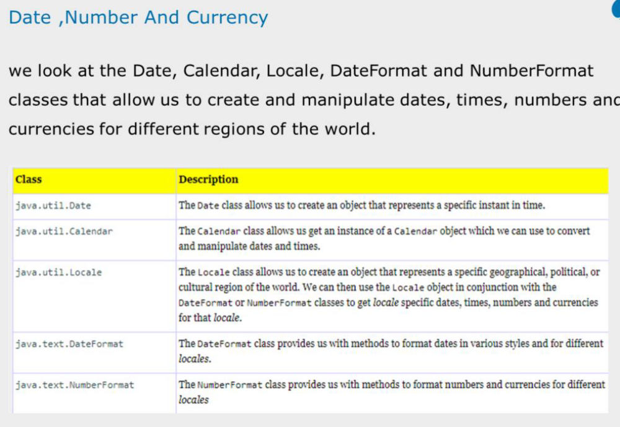
Date, Number and Currency

Slide 24
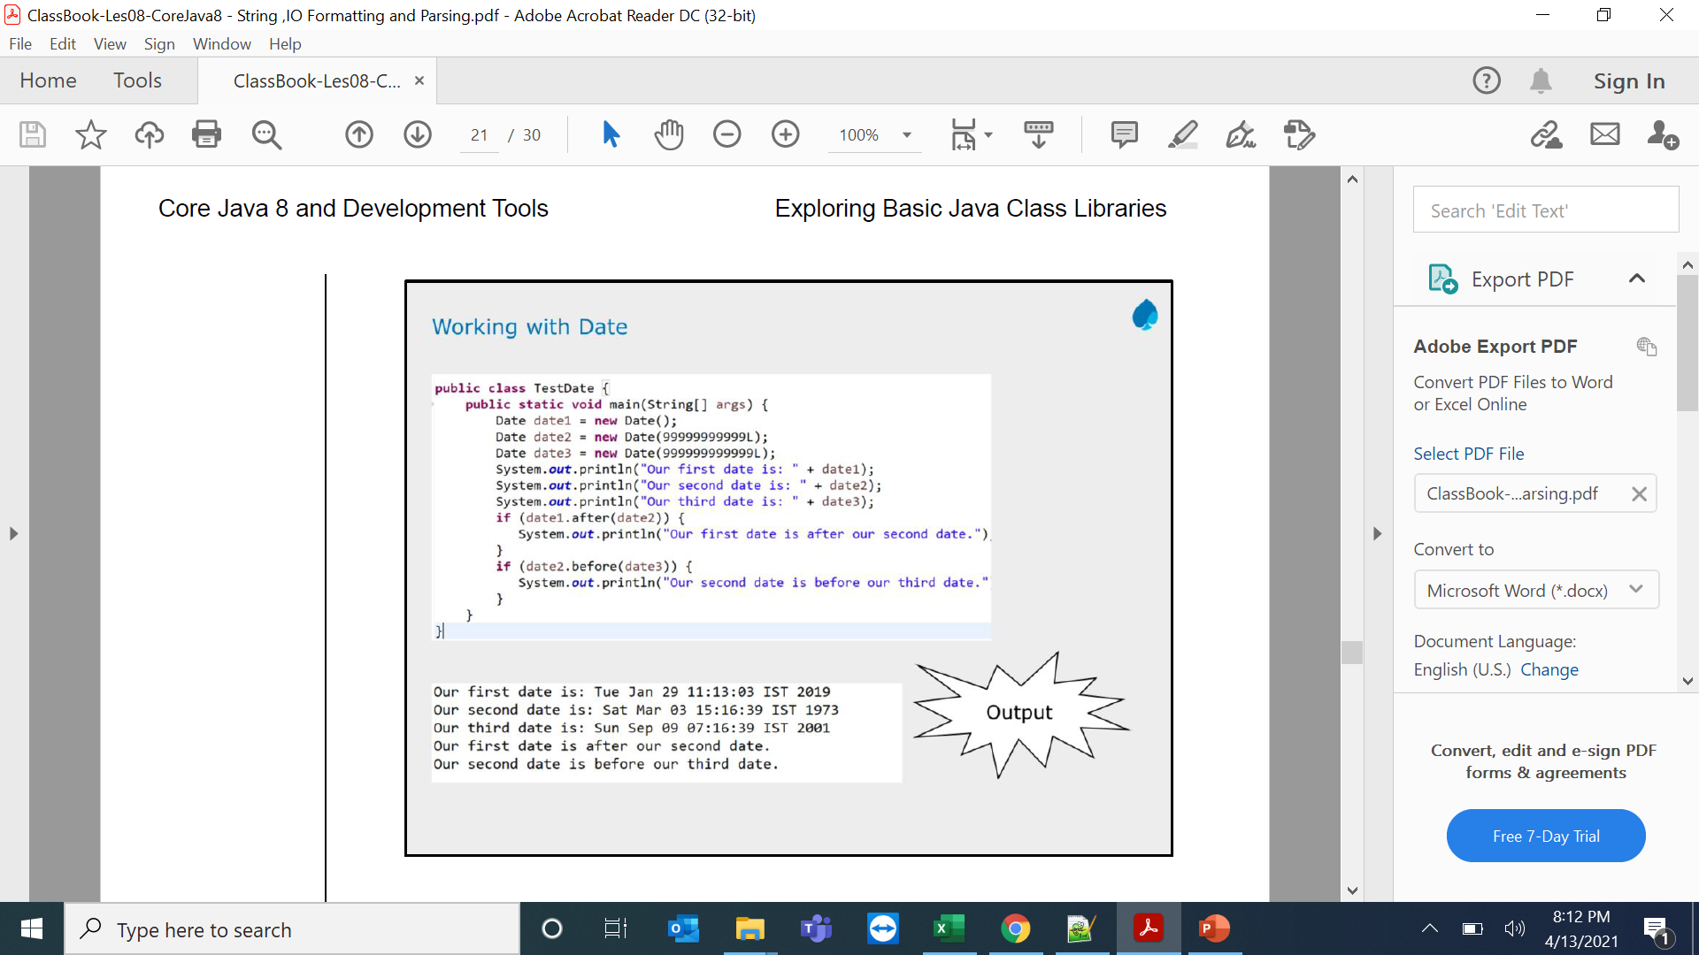
Working with Dates

Slide 25
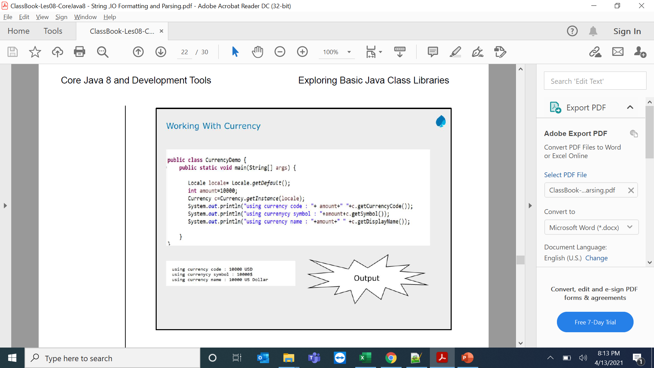
Working with Currency

Slide 26
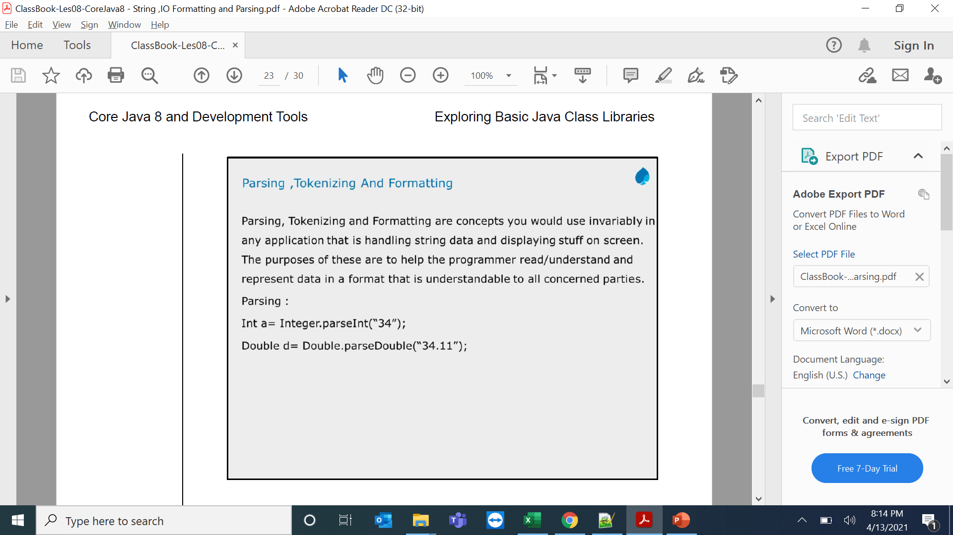
Parsing Tokenizing and Formating

Slide 27
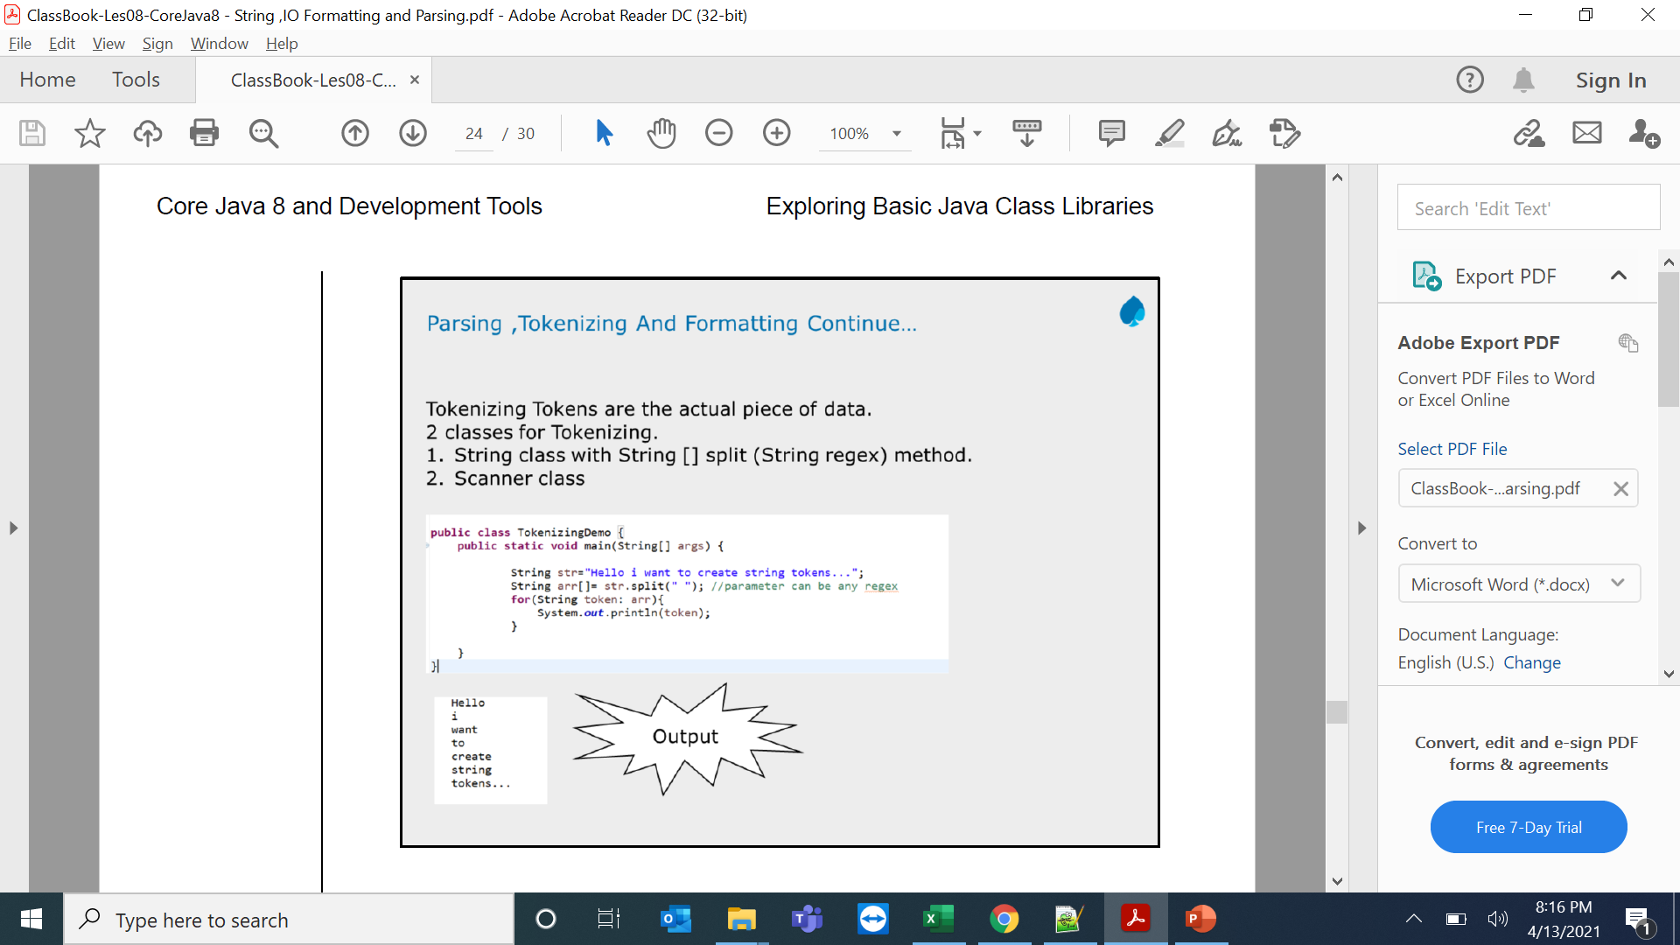
Parsing,Tokenizing and Formating Demos

Slide 28
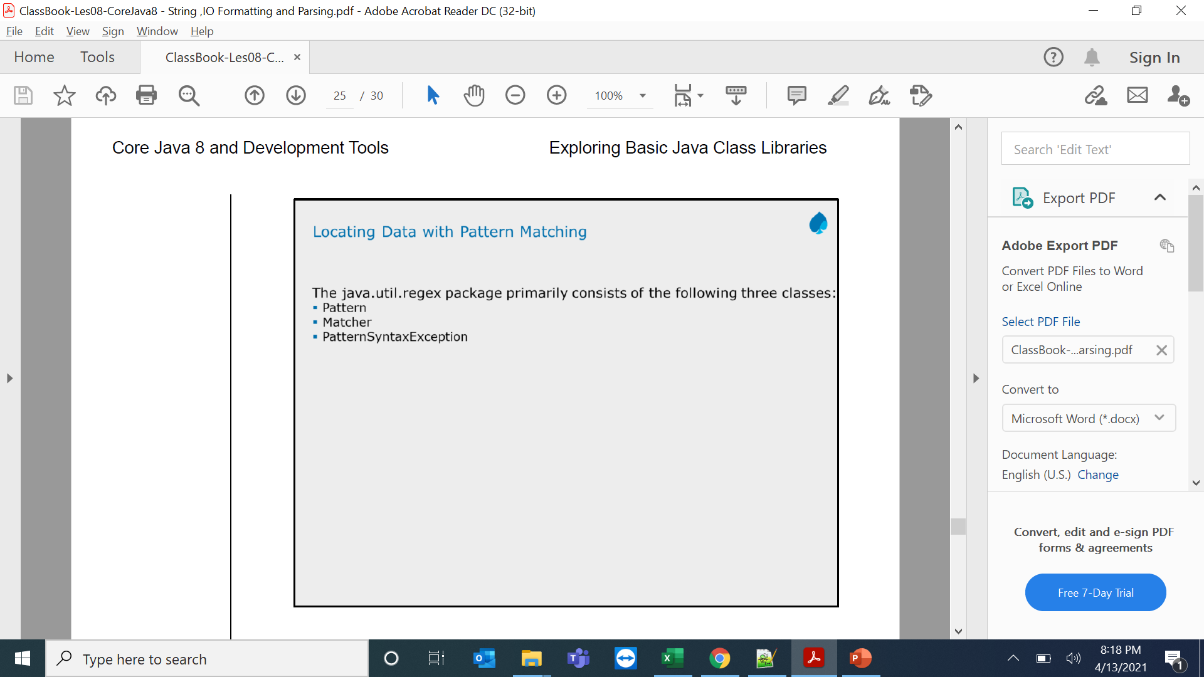
Locating Data with Pattern Matching

Slide 29
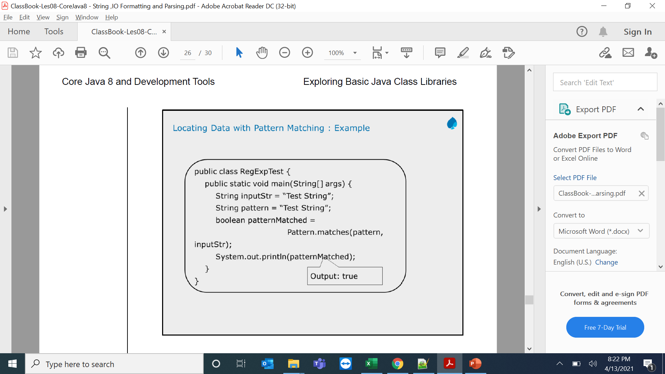
Locating Data with Pattern Matching

Slide 30
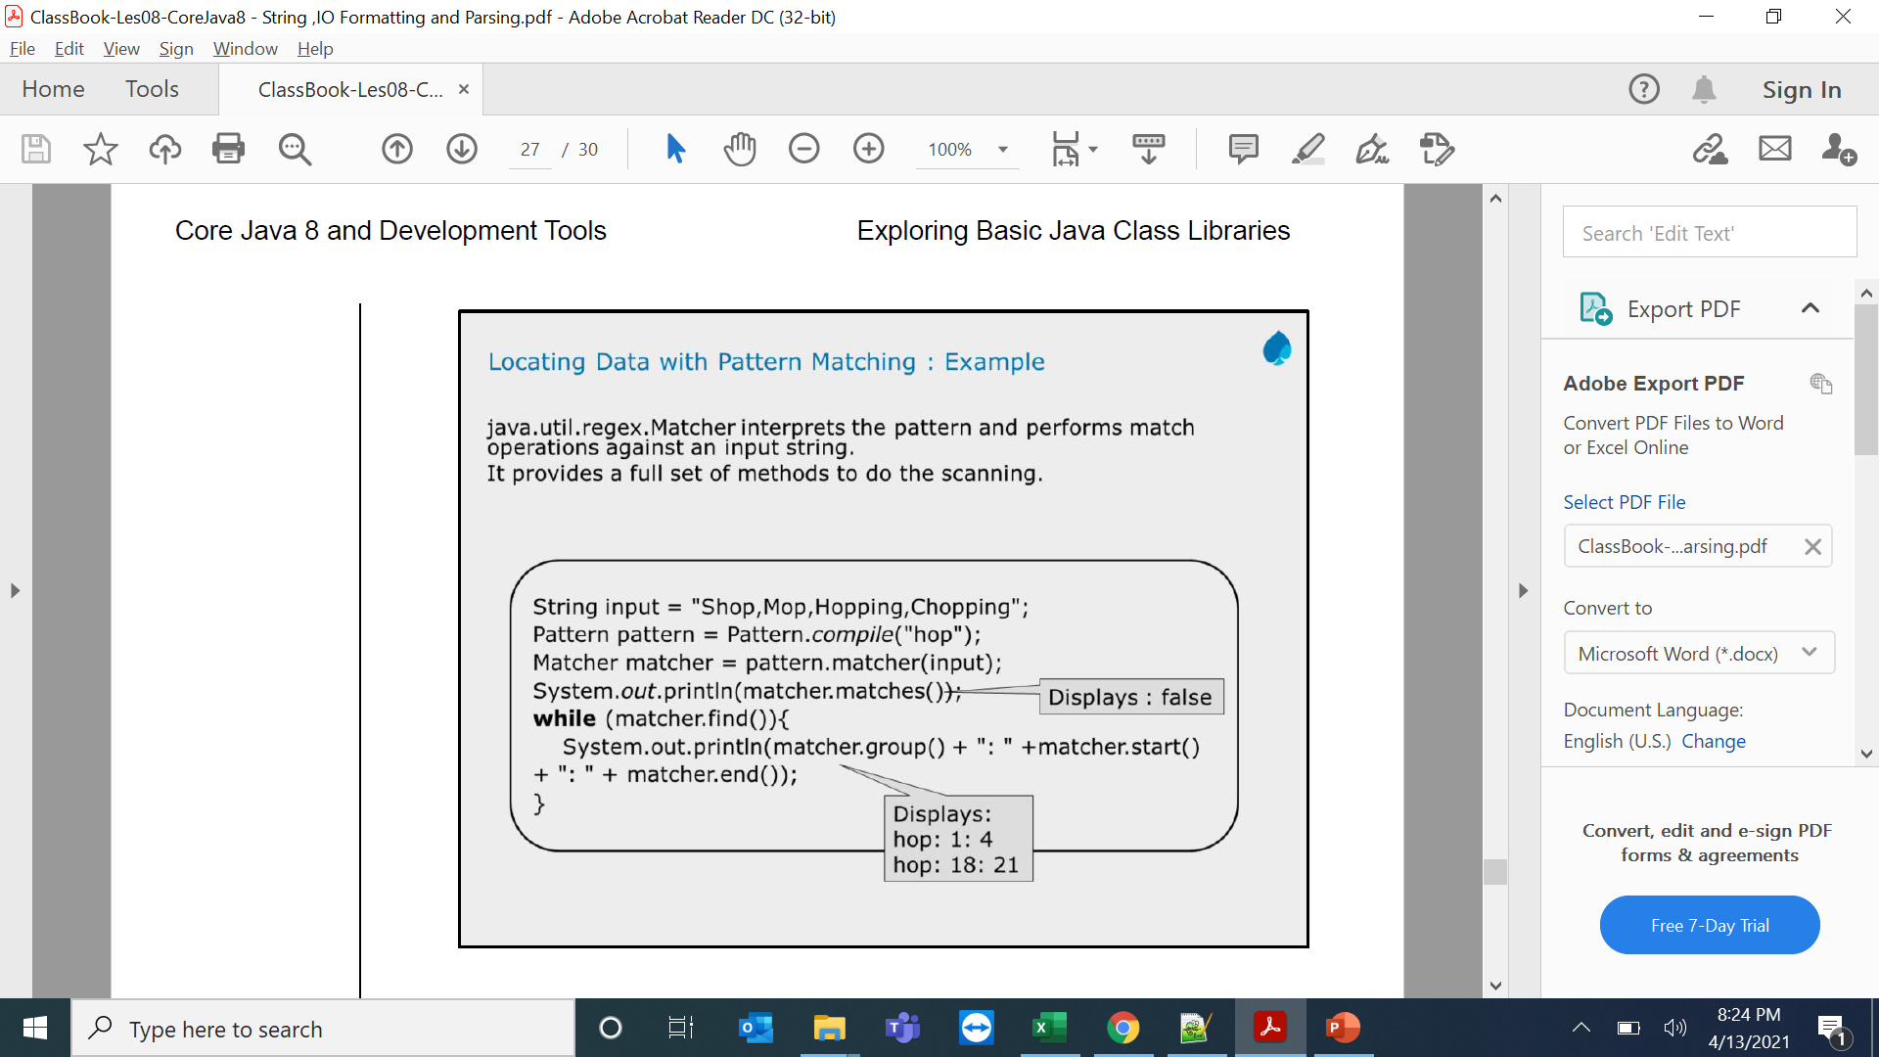
Locating Data with Pattern Matching

Slide 31
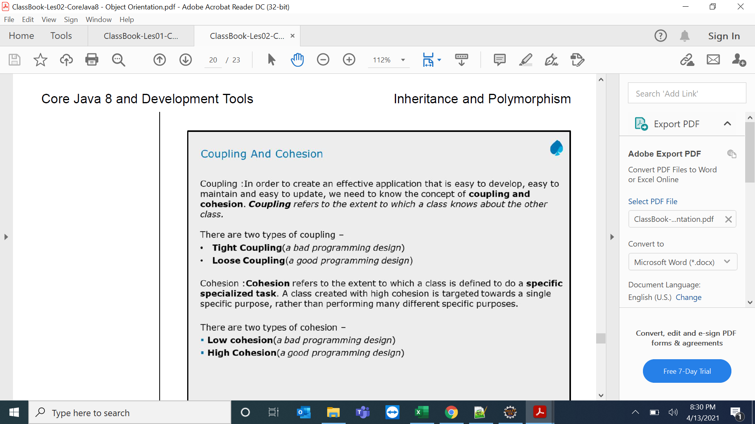
Coupling and Cohesion

